Slide 1


Python Webapp Programming
Questionnaire app with Django
--use login/logout for question answering. Add singup

Slide 2
Utilize the new developed login for question answering
Make the view use Login Mixin thus must login then come to the views (start vote, voting, voted)
No need to record the user_name in session. User str(request.user) as user name (it is done by login to record user name)
Change to use template view instead of the function view.
Start_vote view inherited from View, Voting view inherited from FormView, Voted view inherited from TemplateView.

Slide 3
use git create branch and then later merge
PS> cd 2myprj
PS> git checkout –b add_class_view_singup_form

Slide 4
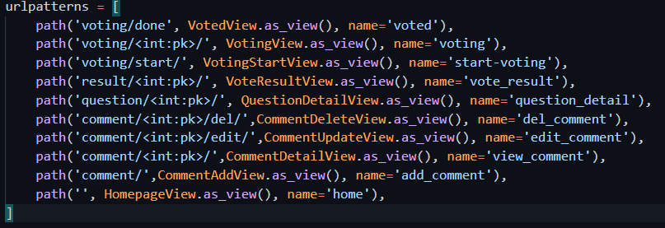
Changed urls.py
Import the new class view, and update the urlpatters to use new class view.

Slide 5
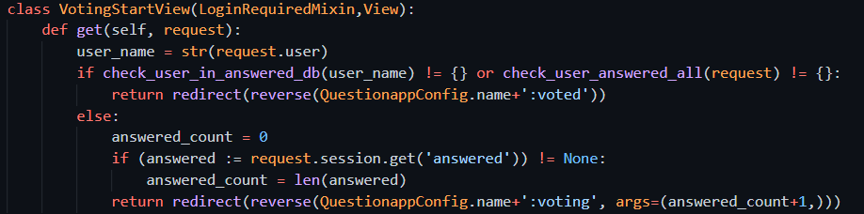
New start vote view
The view class definition:

Slide 6
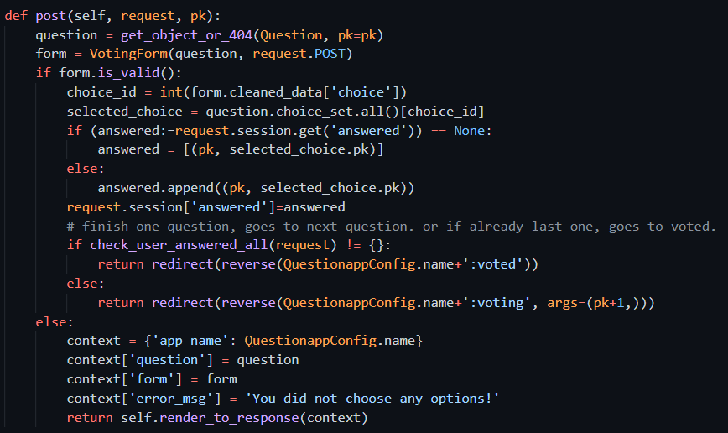
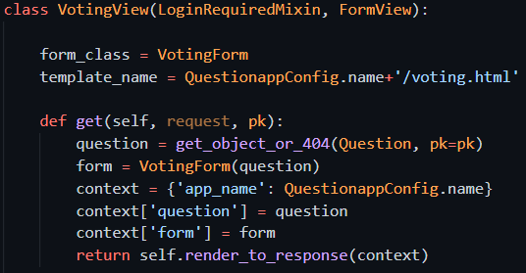
New voting view
View class definition:

Slide 7
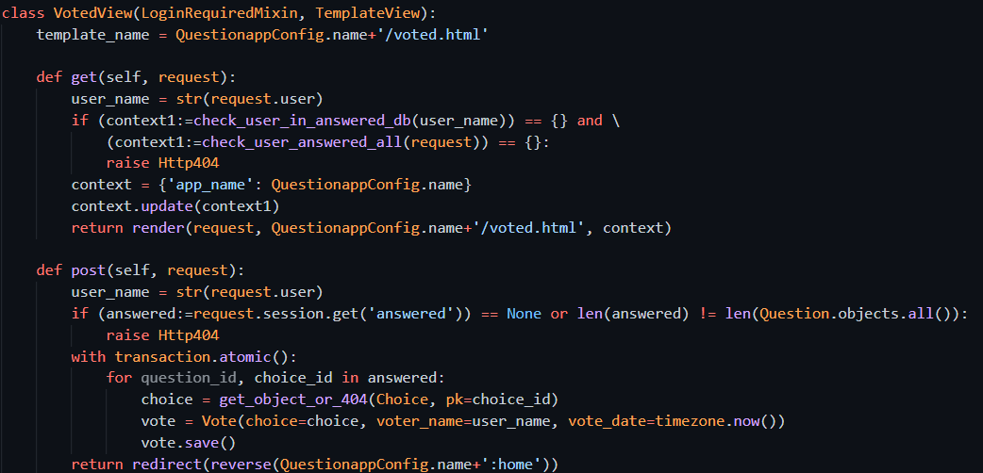
New voted view
View class definition.

Slide 8
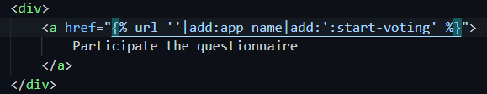
Changed home page link for start answering

Slide 9
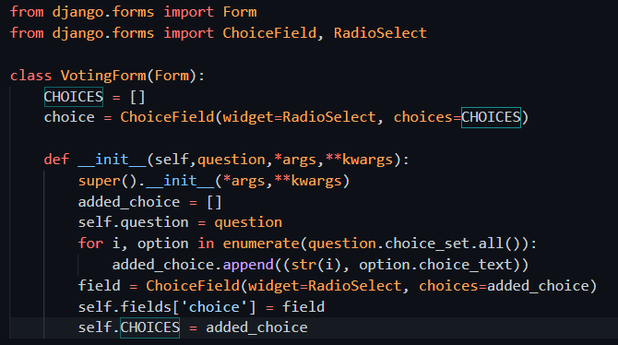
Add Questionapp/forms.py for voting
Voting view need a form
This is a dynamic form (fields cannot be decide fixed. It must be according to the question choices)

Slide 10
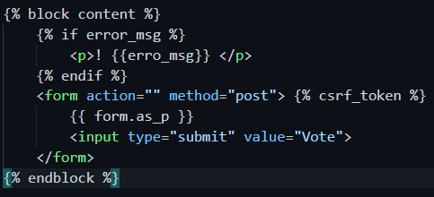
Chang the voting template to use the form defined

Slide 11
Test it
Try test your new added code with the development server

Slide 12
Add sign up for new user register
Django has a UserCreationForm. Also the user database using Django created default one.
We only need to add one signup url conf, add view, add template, then put the sign up link in proper place in your site.

Slide 13
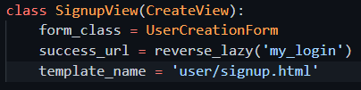
Add a view for the new signup
New singup view class

Slide 14
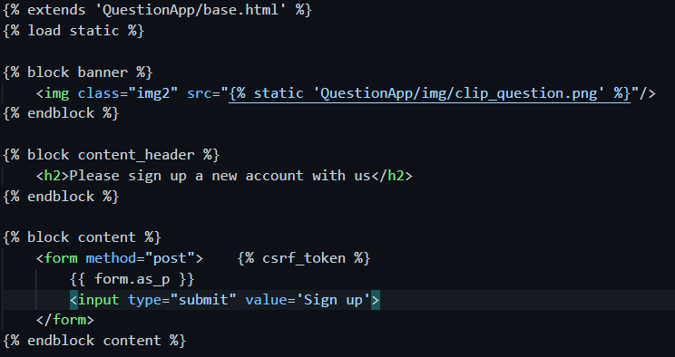
Create template for signup
User/templates/user/signup.html

Slide 15
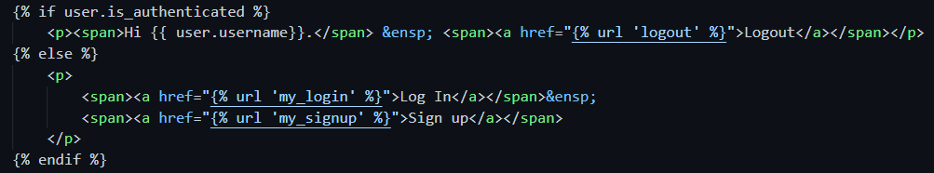
Add signup link at homepage

Slide 16
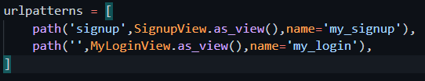
Add url conf

Slide 17
Test it. And further thinking
The frequently needed function we still missing password change. This Django already has a default one which we can user.
And also another one: password reset, allow the user recover password/reset password if he/she forget it. This at real production environment will need email service to accomplish.
To see the default password change: http://localhost:8000/accounts/password_change/

Slide 18
Commit branch change, merge to main, Push to remote, deploy to Heroku
PS> cd 2myprj
PS> git status
PS> git add –A
PS> git commit –m “add signup, add class view”
PS> git checkout main
PS> git merge add_class_view_singup_form
PS> git tag V1.0 –m “release v1.0”
PS> git push origin main
PS> git subtree push --prefix QuestionPrj heroku main
PS> heroku ps:scale web=1

